Slide 1
Reliable UDP and Circular DHT implementation for the MediaSense Open-Source Platform
Bachelor Thesis, Computer Science 2012
Florian Rüter, Timo Schröder
Notes:
----- Besprechungsnotizen (04.06.12 18:40) -----
God Morgon, välkommen till vår presentation. Vi är Timo och Florian.

Slide 2
Background
Internet-of-Things
MediaSense
Peer-to-peer lookup sevice based on DHT => Chord
Reliable packet based data transmission => RUDP
Notes:
----- Besprechungsnotizen (04.06.12 18:40) -----
Project from MIUN.
Founded by the EU
----- Besprechungsnotizen (04.06.12 18:52) -----
Internet-of-Things is a multitude of connected sensors and actors
Sensors/actors might be from all possible kindnesses
Intelligent behaviour of the sensor/actors with or without human influence
MediaSense is a framework that

Slide 3
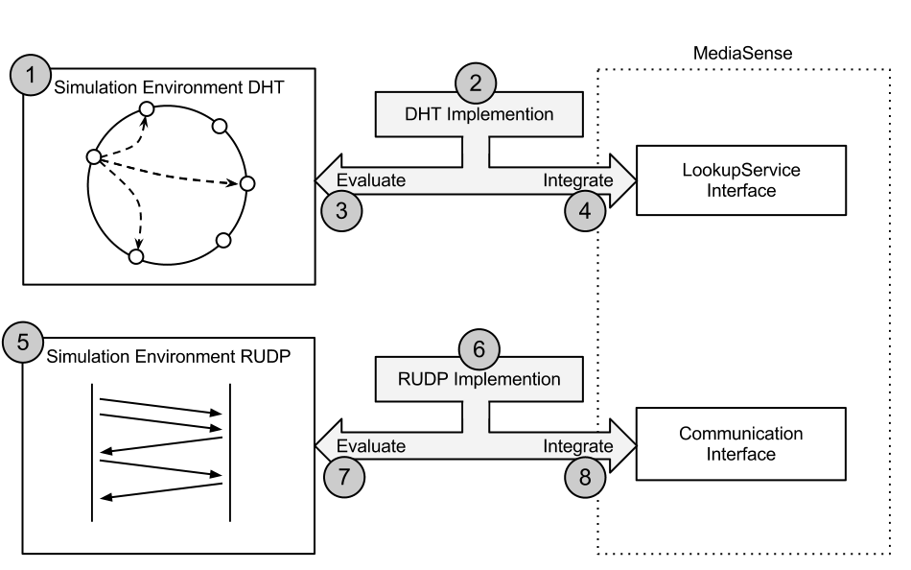
Methodology
Notes:
----- Besprechungsnotizen (04.06.12 18:52) -----
The graphic describes our first
we defined 8 milestones in the beginning of the project
describe the picture
simulation environments are build upon the MediaSense interface

Slide 4
DHT Theory
Database that stores Key-Value pairs
Decentralised / self organising
Chord
Virtual ring
Maximum query effort of O(log₂(n))
Self repair mechanism
Notes:
DHT is short for Distributed Hash Table. A DHT is in general the same as a normal Hash Table which can be seen as a database that stores key-value pairs
In difference to the normal hash table, were the data is stored on a single computer (in fact a server), a DHT is a distributed system and stores the data on the clients of the system.
Because of that, each participating node has to take the same responsibilities to keep the system running.
Distributed Systems have a big advantage compared to Client Server networks, because they have no central point of failure.
One type of a DHT is the Chord protocol. In Chord, the clients are organized in a virtual ring and the maximum effort for a query is O log(n), which in facht means, if a system has
1000 nodes, it takes a maximum of ten steps to solve a query. Additionally Chord uses several self repair mechanism to keep the system running.

Slide 5
DHT Implementation
0
F
F
1
<
E
2
D
3
C
5
4
B
5
A
A
6
7
9
7
8
Notes:
Now lets have a closer look to our DHT implememantation, which is based on the Chord protocol. What you see here is the virtual ring I mentioned before. CLICK
This ring splits up the available has space into smaller sections. The section size is related to the size of the used hash function. In our simple scenario the DHT can host a total of sixteen clients, identified by the hexadecimal number 0-F. CLICK
No consider that a node that has the id five would join this distributed system. As expected the node take place at position 5. CLICK
Imagine 3 more nodes joining the system. Now we have a total of 4 clients. In fact 5, 7, A and F. But we dont know yet how these nodes are related to each other. Let us consider this with the example of of node 5. CLICK
These blue arrows show us the perfect case, where node five would know the nodes which are exactly the half, the fourth, the eigth and the sixteenth of the total circle away from its own position. Unfortunately not all of this nodes are currently reachable. CLICK
In those cases node 5 takes the next node which lays clockwise on the circle as a finger. The references that a node stores to other nodes is also referred to as finger table.

Slide 6
RUDP Theory
Based on UDP
Reliable
Correctness
Order
Acknowledgement of packets
Resending of packets
Flow control
Data in the FIRST packet

Slide 7
RUDP Implementation
Sender
Receiver
4
6
7
1
2
3
4
5
AckStartSeq 1 ACK 1-3,5
1
2
3
5
AckStartSeq 4 ACK 4-7

Slide 8
DHT Results I
Initial situation: Empty DHT
Scenario: Add 10 nodes

Slide 9
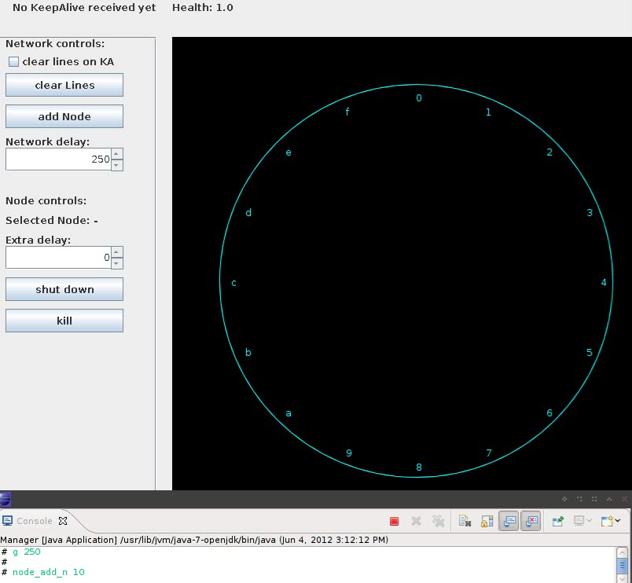
Notes:
The health is a measurement for the correctness of the finger tables in the DHT.

Slide 10
DHT Results II
Initial situation: DHT from the recent video
Scenario: Add 10 more nodes

Slide 11
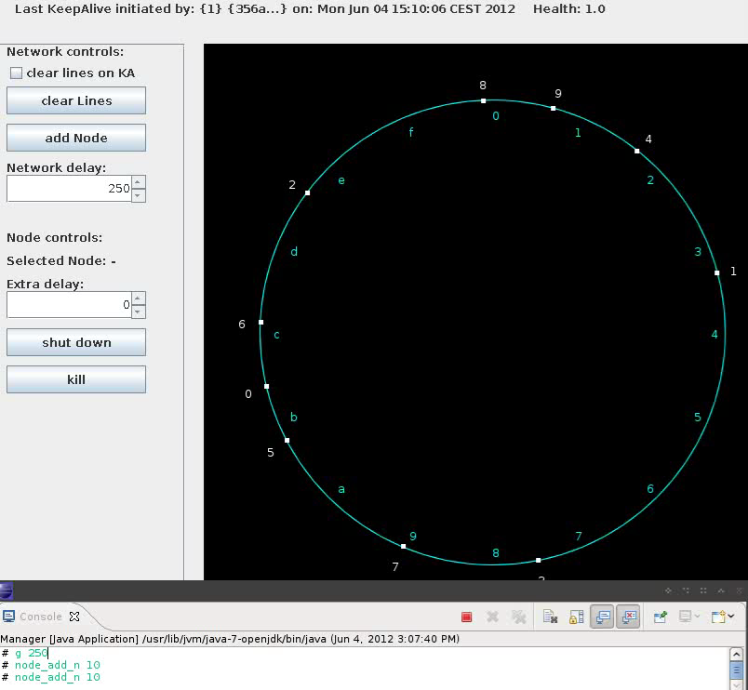

Slide 12
DHT Results III
Initial situation: DHT from the recent video
Scenario: Kill 1 node

Slide 13
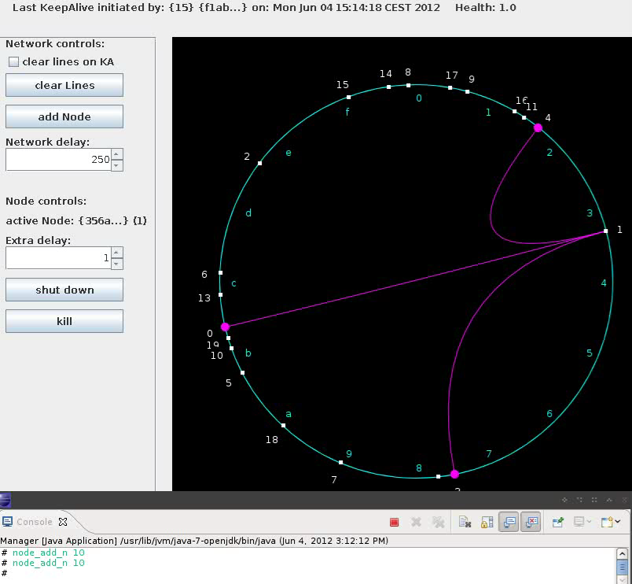

Slide 14
DHT Result IV (Health)
Notes:
This statistic measures the health of the DHT in the scenario of regularly leaving and failing nodes. The scenario starts with a running DHT of 500 nodes and afterwards removes or kills every 5 seconds 5 nodes. Because of the leave broadcast message which provides useful information of the leaving node, the DHT can keep ist health nearly constantly at 100%. That is not the case if the nodes fail. But still if 50 nodes (what is in this case is 10% of the total amount of nodes) fail, the health rops only to 90% and recovers fast against 100%.

Slide 15
DHT Result V (Traffic)
Notes:
In this scenario we measuring the averge traffic that is caused by the DHT for every user. We start with an empty DHT and immediately insert 500 nodes. After the initial insertion process which is finished after approximatelly 80 seconds. The traffic normalizes against 0.2 kb per second which is caused by the repair mechanisms. At second 180, 1 node is removed from the DHT which cant be registered in the average traffic. Same for second 240 where 1 node fails. And second 300 where 1 extra has been inserted. If we repeat this with 10 nodes removing/killing/insertion we can see little peaks. That peaks become more obvious if we do the same with 50 nodes. It shows that the traffic nearly doubles if thre is a highly leave or fail rate of the clients.

Slide 16
RUDP Result I (Delay)

Slide 17
RUDP Result II (Loss)

Slide 18
Conclusion
8 Milestones have been implemented
DHT and RUDP fulfil the set requirements
Problem solved

Slide 19
Future work
Consider security vulnerabilities
Advanced testing of the implementations
Flexible connection parameters for RUDP like
Variable window size
Different ACK packet timer strategy
Flexible send timeout based on RTT

Slide 20
Thank you!
Any questions??

